Slide 1

Bactopia tools
11/27/2023

Slide 2
Outline
rgi (resistance gene identifier)
Questions
Seqsero2
Agenda
Updates

Slide 3

Agenda
December 11 – Bactopia Tools: shigatyper and shigeifinder
January 8 – Bactopia Tools: spatyper and ssuissero
Future Trainings
ONT & FL’s Flisochar pipeline
StaPH-B Toolkit Programs/Pipelines
GISAID flagged SARS-CoV-2
R Training Series
Dryad pipeline
…and more

Slide 4
Updates
AMD Southeast Region Annual Needs Assessment Survey is sent out last Tuesday. Please make sure you finish the survey before December 22nd
Feel free to forward the survey to any new staff member not included in this email
Also, please have at least one staff member respond back to make any updates to your lab AMD contact list

Slide 5
rgi (resistance gene identifier)
Predicts antibiotic resistome(s) from protein or nucleotide data based on homology and SNP models
Uses reference data from the Comprehensive Antibiotic Resistance Database (CARD)
RGI analyses can be performed via the CARD website RGI portal, via use of a Galaxy wrapper for the Galaxy platform, or alternatively you can install RGI from conda or run RGI from Docker
arpcard/rgi: Resistance Gene Identifier (RGI). Software to predict resistomes from protein or nucleotide data, including metagenomics data, based on homology and SNP models. (github.com)

Slide 6
Installation
Available on HPG
Can be installed through conda
module load rgi/6.0.2
conda create –yp /blue/bphl-<state>/<user>/conda_envs/rgi/
conda activate /blue/bphl-<state>/<user>/conda_envs/rgi/
conda install –c conda-forge –c bioconda rgi

Slide 7
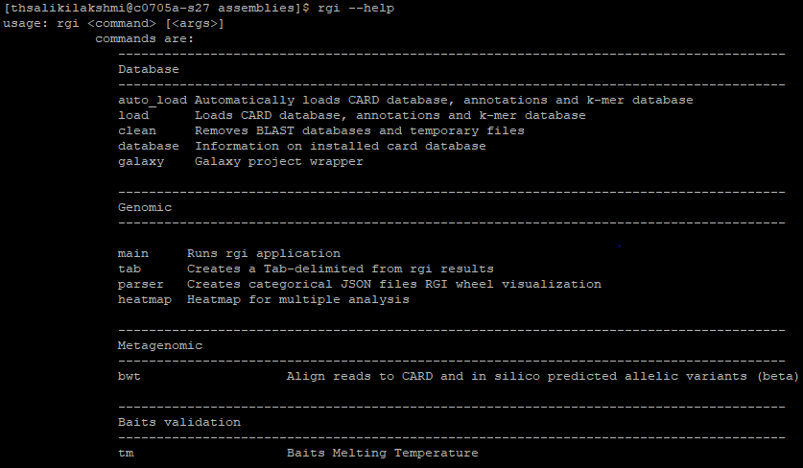
Usage

Slide 8
Input
$ rgi main -i JBI22000793.fasta -o rgi_results

Slide 9
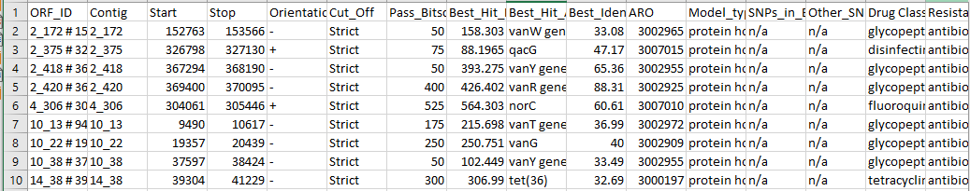
Results

Slide 10
seqsero2
SeqSero is a pipeline for Salmonella serotype determination from raw sequencing reads or genome assemblies
denglab/SeqSero: Salmonella serotyping from genome sequencing data (github.com)

Slide 11
Installation
Can be installed through conda
conda create -yp /blue/bphl-<state>/<user>/training/conda_envs/seqsero2/
conda activate /blue/bphl-<state>/<user>/training/conda_envs/seqsero2/
conda install -c conda-forge -c bioconda seqsero2

Slide 12
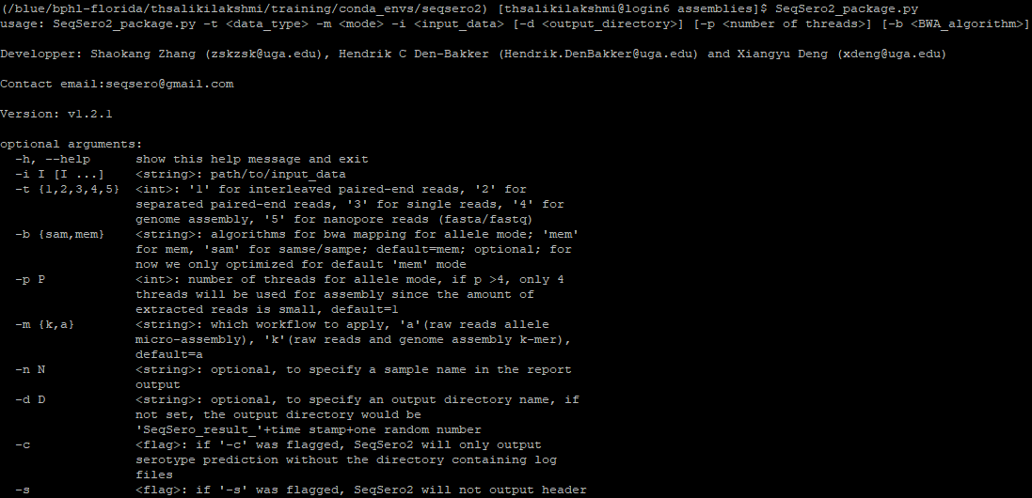
Usage

Slide 13
Input
Inputs can be paired reads or assemblies
$ SeqSero2_package.py -t 4 -m k -i JBI22000631.fasta

Slide 14
Results
Output directory: /blue/bphl-florida/thsalikilakshmi/data/jbi/20220825_jax_220629_PLN_WLK_MS/assemblies/SeqSero_result_08_01_2023_09_08_489346851
Input files: JBI22000631.fasta
O antigen prediction: -
H1 antigen prediction(fliC): -
H2 antigen prediction(fljB): -
Predicted identification: -
Predicted antigenic profile: -:-:-
Predicted serotype: - -:-:-
Note: The input genome cannot be identified as Salmonella. Check the input for taxonomic ID, contamination, or sequencing quality.

Slide 15
Questions?
bphl-sebioinformatics@flhealth.gov
Lakshmi Thsaliki, MS
Bioinformatician
Lakshmi.Thsaliki@flhealth.gov
Molly Mitchell, PhD
Bioinformatician
Molly.Mitchell@flhealth.gov

